Slide 1
Lung Cancer Prediction using Data Mining techniques
Data Mining Project

Slide 2
Why do we do Cancer Prediction??
The increase in population coupled with the growth in diseases has necessitated the inclusion of data mining in medical diagnosis to extract the underlying pattern. Of these, cancer claims over 7 million lives every year and lung cancer accounts for 18% of these mortalities.
Existing medical techniques like X-Ray, Computed Tomography (CT) scan, sputum cytology analysis are of complex equipment with high cost and also proven to be efficient only in stage 4, when the tumor has spread to other parts of the body.
The proposed system involves the development of a data mining tool that will help in the classification of patients into the category that could potentially test positive for lung cancer in stage 1.

Slide 3
About Lung Cancer (briefly....)
Indications for Cancer disease
Cancer is two types i.e., Non-Small Cell Lung Cancer (NSCLC), Small Cell Lung Cancer (SCLC) and Mixed Small Cell/Large Cell Cancer ( if both).
Symptoms
Chest, shoulder, or back pain that doesn't go away.
Weight loss and loss of appetite.
Repeated respiratory infections, such as bronchitis or pneumonia.
cough that does not go away and gets worse over time
Risk factors
Smoking: i. Beedi ii. Cigarette iii. Hukka
Second-hand smoke.
Air pollution.
Insufficient consumption of fruits & vegetables.
Suffering with other types of malignancy

Slide 4
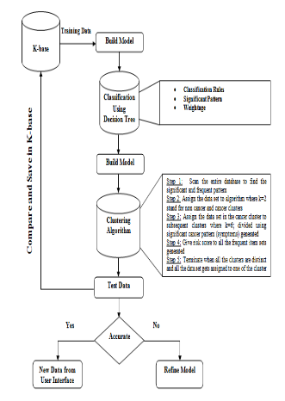
Model
Step 1
The gathered data is preprocessed, fed into the database and classified to yield significant patterns using decision tree algorithm.
Step 2
Then the data is clustered using K- means clustering algorithm to separate cancer and non cancer patient data.
Why Decision tree algorithm?
Why K-Means Clustering algorithm?

Slide 5
Datasets
Kaggle Website
https://www.kaggle.com/c/data-science-bowl-2017
Machine Learning Repository
https://archive.ics.uci.edu/ml/datasets/lung+cancer
Attributes can be “Age, Marital status, Symptoms relating to cancer, occupational hazards, family history of cancer” etc.

Slide 6
Classification and Significant Pattern Generation
The frequent itemsets that occur throughout the database and have a significant link to cancer status are mined as significant patterns.
The data is fed into the decision tree algorithm to obtain the significant patterns related to cancer and non cancer data sets.
Weightage to Significant Pattern
Weightage is calculated for every frequent pattern based on the attributes to analyze its impact on the output.
They should satisfy the condition Sw(i)=Sum of (W(i)*F(i)) where
Sw = Significant Weightage , W(i) = Weightage of each attribute ,
F(i)= Frequency of the rule to take it as a Significant pattern.

Slide 7
Example of Significant pattern
Example of Decision rule
Risk scores and their respective attributes
Age - gender - living area - family history- anemia-symptoms -> none- Cancer Type -> None.
Weightage =100.55
Age | x<30 30 < x < 40 40< x < 60 | 3 4 5
Habits | Smoking Alcohol Chewing Hot beverage | 3 5 3 2
Family History of Cancer | Yes No | 5 1
If symptoms = none and risk score = x <45 then
result = you don’t have cancer,
tests = do simple clinical tests to confirm.
*All these attributes and their risk scores are tentative and they could be modified to increase accuracy.

Slide 8
K-Means Clustering
The instances are now clustered into a number of classes where each class is identified by a unique feature based on the significant patterns mined by the decision tree algorithm.
The aim of clustering is that the data object is assigned to unknown classes that has a unique feature and hence maximize the intraclass similarity and minimize the interclass similarity.
Algorithm
Input: K- the number of clusters, D- data set containing n objects.
Output: Clusters
Step 1:
Choose two mean values from weightage of significant patterns as the initial cluster centers.

Slide 9
Step 2:
Choose two mean values from weightage of significant patterns as the initial cluster centers.
Step 3:
Assign each object to the cluster to which it is most similar based on the
mean value of the weightage
Step 4:
Update the cluster means by calculating mean value of all the objects in the cluster
Now two clusters have been generated based on the weightage
scores of the significant pattern. The two clusters are named as Non cancer and Cancer clusters

Slide 10
Thank you...
COE15B019
COE15B029
CED15B010
CED15BI033

